Slide 1


AI-Powered Multimodal Contactless Patient Monitoring System
Using the Hospital Bed as an Unobtrusive Sensing Platform

Slide 2


The Monitoring Gap in Indian Hospital Wards
Reality | Impact
15-40 patients per nurse in general wards | Vital signs checked only every 4-8 hours
Heavy documentation workload | Nurses spend less time at the bedside
ICU monitors unavailable in general wards | Long unmonitored windows between rounds
Patient deterioration can be gradual and silent | Early signs missed until acute crisis
A patient can deteriorate and recover - or not - between two manual rounds.

Slide 3

Why Contact-Based Monitoring Has Limits
The problem with wires and patches:
Sensor Displacement -ECG leads and oximeter clips detach during sleep or movement, triggering false alarms
Skin Discomfort -Adhesive electrodes cause irritation and skin tears in elderly and pediatric patients
Alarm Fatigue -Frequent false disconnection alarms cause nursing staff to ignore monitor alerts
Maintenance Overhead -Cables require constant cleaning, untangling, and replacement
Incomplete Records -Detached sensors create gaps in continuous monitoring data

Slide 4
Contactless Systems Already Work - in Labs and Hospitals
Study | Technology | Key Result | Patients
Padaki et al., Jan 2026 | Camera rPPG (smartphone/webcam) | HR RMSE 1.62 bpm · RR RMSE 1.71 bpm | 111 ED patients
Shaya, Levy et al., Jun 2026 | 24 GHz Doppler Radar (TAMAR) | RR LOA ±1.6 bpm confirmed in real EDs | 315 ED patients, 3 hospitals
Pitafi et al., Feb 2026 | Geophone under mattress + Raspberry Pi | HR/RR MAE < 2 bpm on edge hardware | Synthetic + 75 human references
Chen et al., 2024 | mmWave FMCW Radar (76–81 GHz) | Contactless chest displacement feasibility confirmed | Controlled lab
Lee, Kim & Jeong, Aug 2025 | Load cells on bed frame | 96.26% fall/bed-exit detection accuracy | Healthy adults

Slide 5
Why Existing Contactless Systems Are Not the Answer
Requirement | Commercial Smart Beds | Single-Sensor Radar/Camera | Our Approach
Cost per bed | ₹10–50 lakh | ₹5–15 lakh (full setup) | ₹64,280
Works on existing beds | ❌ Replace entire bed | ❌ Requires fixed installation | ✅ Retrofit any cot
Multiple sensing modalities | Some | ❌ One sensor only | ✅ Five sensors
Handles movement/visitors/ blankets | ❌ No | ❌ No — silently fails | ✅ Explicitly detects and flags
Accessible to resource-constrained wards | ❌ No | ❌ No | ✅ Yes

Slide 6
The Silent Failure Problem
What happens when a single sensor is disturbed:
Disturbance | What the Sensor Sees | What It Reports
Patient turns over | Radar phase noise spike | Reports erratic RR — may look like tachypnea
Visitor sits on the bed | Radar detects visitor's breathing | Reports visitor's RR as patient's RR
Thick blanket covers patient | Thermal camera reads blanket surface | Reports ambient temperature as body temperature
This is the silent failure problem:
The sensor produces a plausible-looking but clinically wrong number - with no warning.
"A sensor that fails loudly is safe. A sensor that fails silently is dangerous."
— TAMAR 315-patient trial (Shaya et al., Jun 2026): 30% of measurements were invalid under real conditions.

Slide 7
Our Approach: The Hospital Bed as a Sensing Platform
Sensor | Where
60 GHz mmWave Radar | Headboard, facing patient chest
Geophone (BCG vibration sensor) | Under the mattress, beneath upper torso
Pressure Matrix (12×12 grid) | On the mattress surface, under a thin sheet
4× Load Cells | Under each bed leg, inside footpad plates
Thermal Camera + Point IR | Overhead arm (1.2 m) + headboard
The Retrofit Concept:
No new beds required — sensors attach to any existing single-person metal cot
Zero leads or patches on the patient
Zero change to nursing workflow
Five sensors, each placed unobtrusively:
The bed becomes the sensor. The patient simply lies down.

Slide 8
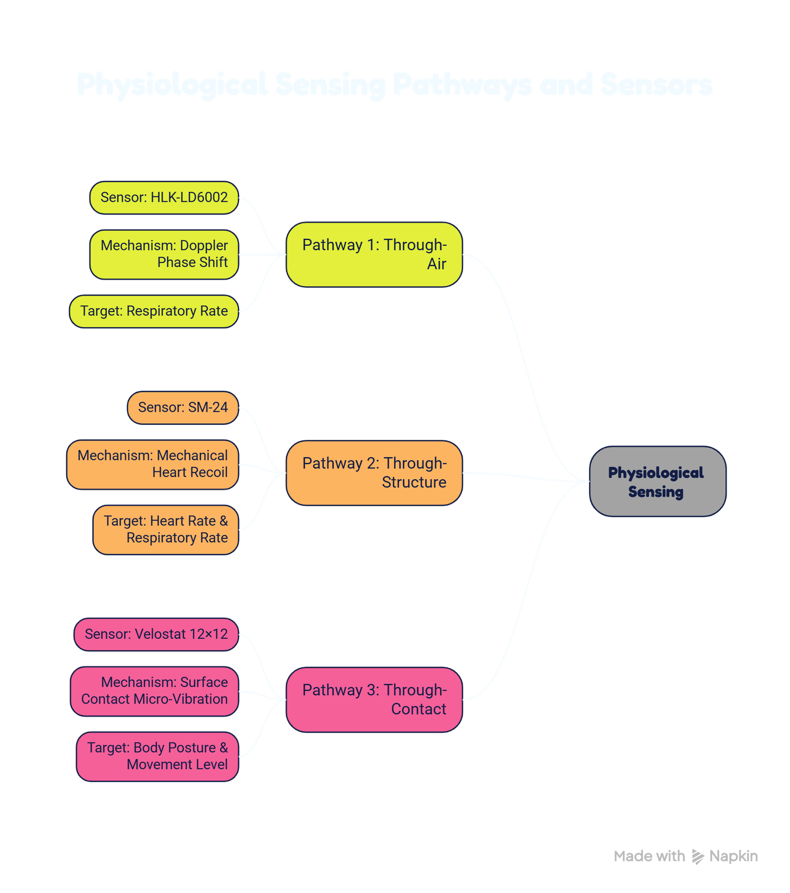
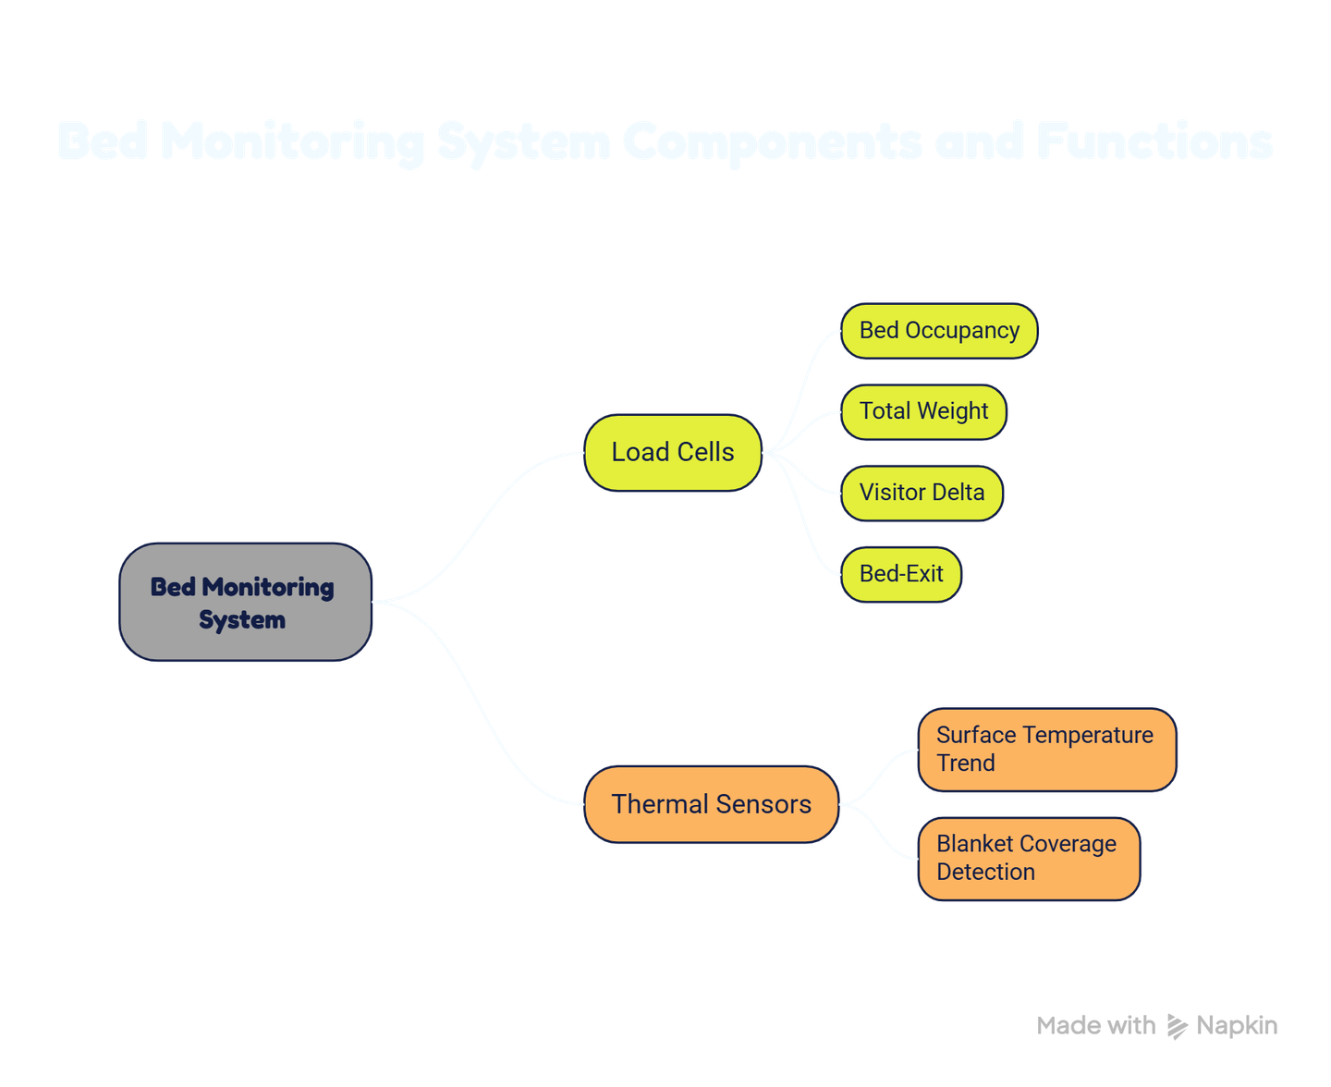
Five Sensors — Three Independent Measurement Pathways
Three independent ways to measure breathing and heartbeat:

Slide 9
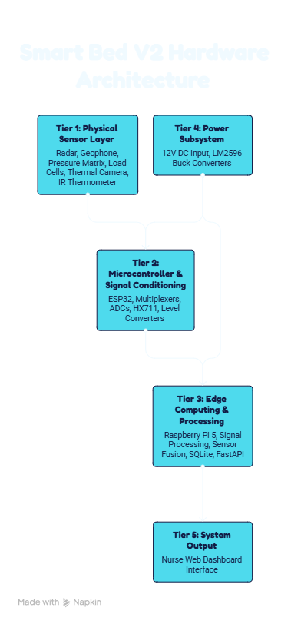
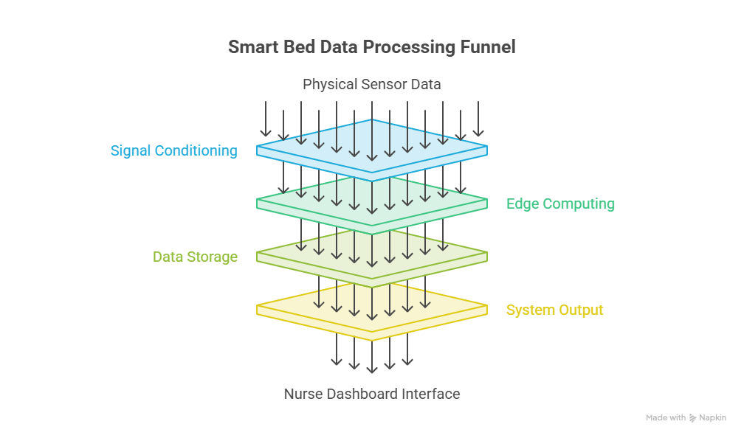
Hardware Architecture

Slide 10
Components and Their Roles
Component | Role
Raspberry Pi 5 (8 GB) | Edge compute: signal processing, fusion engine, FastAPI server
ESP32 WROOM-32 | MCU: multiplexes pressure matrix (12×12), reads load cells, publishes via MQTT
ADS1115 ×2 | 16-bit ADC for geophone and pressure matrix analog signals
CD74HC4067 Mux ×3 | Scans 12×12 pressure matrix grid (144 cells)
HX711 ×2 | 24-bit ADC for 4 load cells (2 full-bridge pairs)
12 V 5 A Supply + LM2596 ×3 | Regulated 5 V and 3.3 V rails for MCU and sensor subsystems

Slide 11
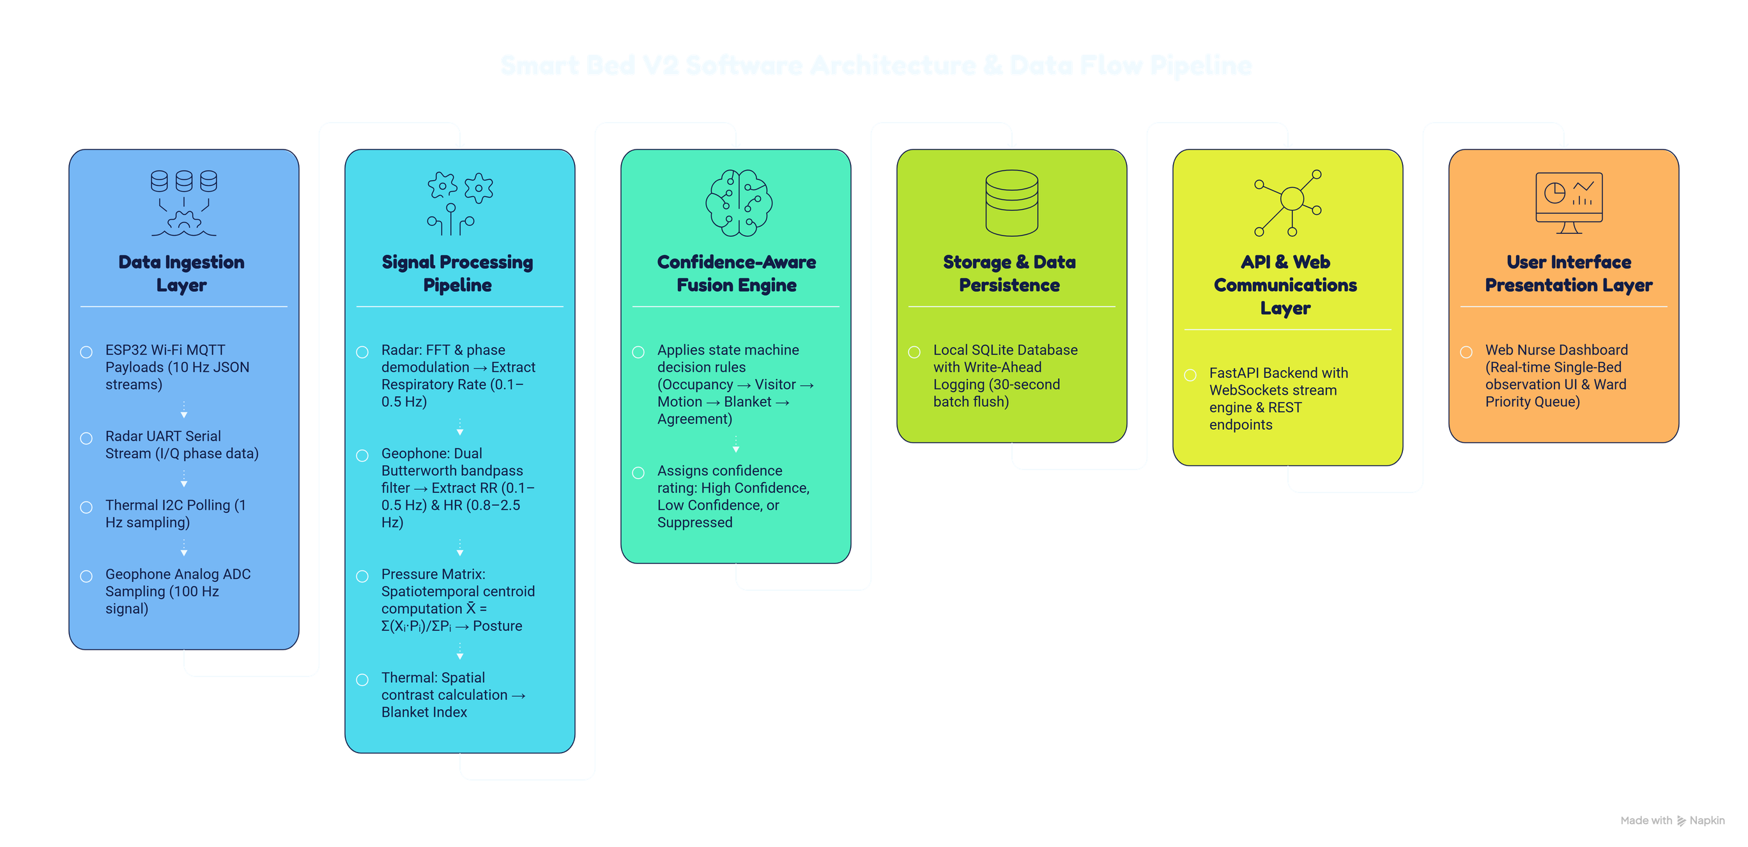
Software Architecture

Slide 12
Data Flow
Stage | What Happens
Ingestion | ESP32 MQTT + Radar UART + Thermal I2C + Geophone ADC → raw data collected
Signal Processing | FFT (radar RR), dual bandpass (geophone RR + HR), centroid calculation (pressure)
Fusion Engine | Confidence state machine — occupancy, visitor, motion, blanket, 3-way agreement
Storage | SQLite database, flushed every 30 s
API | FastAPI WebSocket streams live data to dashboard
Dashboard | Nurse-facing single-bed view + Phase 2 ward queue

Slide 13
The Confidence-Aware Fusion Engine
Step | Rule / Check | Trigger Condition | Resulting System State & Action
1 | Occupancy Check | Load cells ≤ Tare weight baseline | 🔴 Bed Unoccupied — Suppress all physiological outputs
2 | Visitor Gate | Weight delta > 30 kg OR 2nd centroid | 🟠 Visitor Detected — Suppress vitals, raise alert
3 | Motion Gate | Pressure grid temporal change > threshold | 🟡 Patient Moving — Pause radar & geophone RR (30 s)
4 | Blanket Gate | Thermal contrast index < 0.3 | 🟡 Body Obscured — Suspend temperature reading only
5 | 3-Way Agreement | Radar RR & Geophone RR agree within ±2 bpm | 🟢 High Confidence — Publish all validated vitals
6 | Pathway Disagreement | Radar RR & Geophone RR disagree >2 bpm | 🟡 Low Confidence — Publish vitals with warning flag

Slide 14
From One Bed to a Ward
These recordings are synthetically composed into multi-bed ward snapshots.
An XGBoost classifier is trained on the snapshots to rank patient priority.
SHAP generates a readable explanation for every decision:
"Bed 3 — HIGH PRIORITY: Elevated RR +35% above baseline (High Confidence) → +0.42 · Sustained sacral pressure 2.2 h → +0.31 · Surface temp +0.7°C → +0.18"
Phase 2: Software Ward Simulation
The single-bed prototype collects real, labelled scenario recordings:
Scenario Label | What the prototype recorded
quiet_rest | Still patient, stable RR, normal temperature
elevated_rr | RR elevated >20% above personal baseline
sustained_pressure | Same body region under load > 2 hours
bed_exit_attempt | Load cell weight dropping, centroid at edge
visitor_present | Weight delta +30 kg, second pressure centroid

Slide 15
What the Dashboard Tells Nurses
Single-Bed View (Phase 1):
Display Element | What It Shows
Occupancy Status | Occupied / Unoccupied (green / grey)
Body Position | Supine / Left Lateral / Right Lateral / Seated
Respiratory Rate | e.g. 16 bpm 🟢 High Confidence
Surface Temperature Trend | e.g. +0.4°C over last 60 min
Movement Level | Low / Medium / High
Active Alerts | e.g. "Patient stationary 3 hours — check pressure risk"

Slide 16
What the Dashboard Tells Nurses
Ward Priority View (Phase 2):
Bed | Status | Priority | Reason
Bed 3 | Occupied, Supine | 🔴 HIGH | Elevated RR + sustained pressure
Bed 7 | Occupied, Moving | 🟡 MEDIUM | Patient restless — readings paused
Bed 1 | Occupied, Supine | 🟢 LOW | Stable, all sensors agree
No diagnostic claims. All outputs are observational alerts, not medical judgements.

Slide 17
Evidence, Research Novelty, & Expected Contribution
Built on recent peer-reviewed evidence:
Paper | Key Support
Lee et al. (Aug 2025) | Load cells: 96.26% bed-exit detection
Pitafi et al. (Feb 2026) | Geophone BCG on Raspberry Pi: MAE < 2 bpm
Shaya et al. (Jun 2026) | 315-patient radar trial — 30% silent failure justifies our fusion approach
Reyes et al. (2026) | Multi-patient radar unsolved — justifies our simulation approach
Expected outputs:
Validated single-bed prototype with documented sensor accuracy
Labelled scenario dataset from 10 volunteer sessions
SHAP-explainable multi-patient simulation model
Conference / journal paper
"No study has demonstrated a system under ₹65,000 combining three independent physiological pathways with explicit confidence-aware interference detection and simulation-based explainable ward prioritisation."

Slide 18
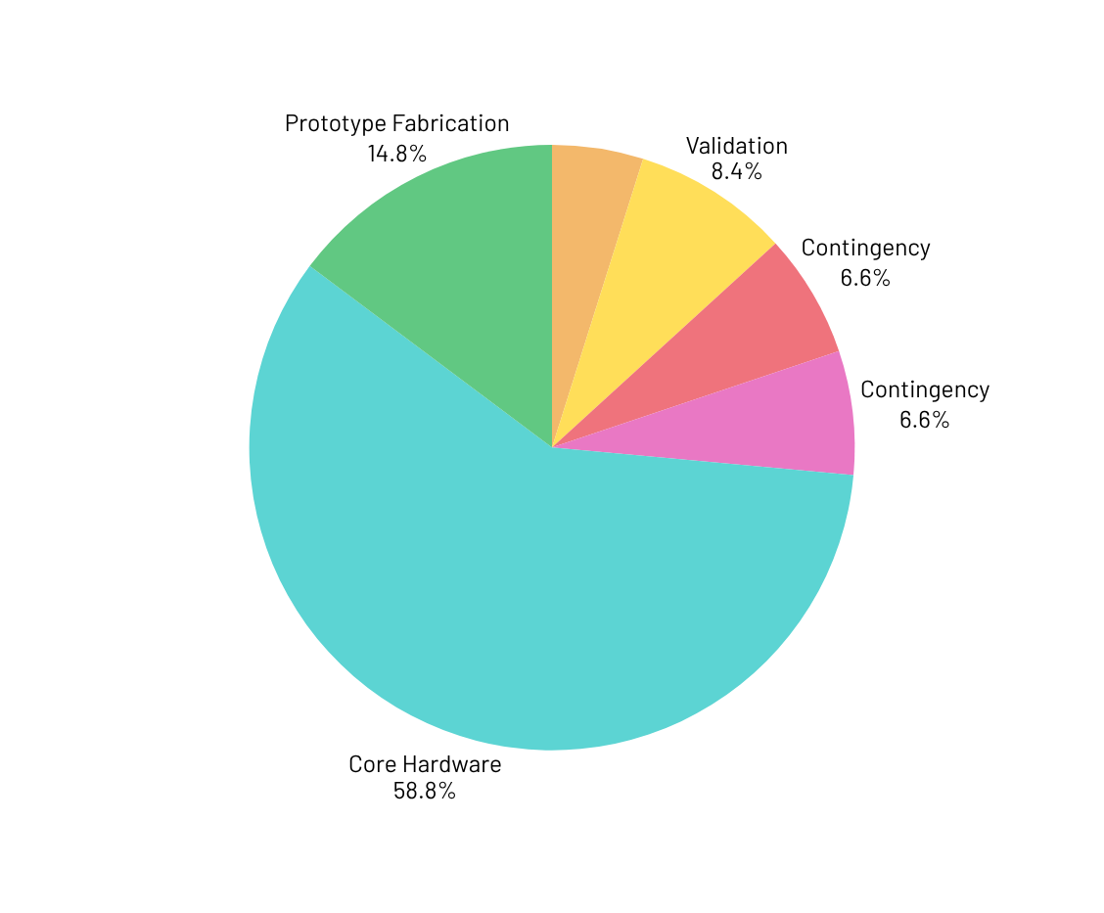
Budget
Section | Amount (₹) | Key Components Included
Core Hardware | 40,465 | RPi 5 8GB (₹20k), Radar, Geophone, Velostat matrix, Load cells, MLX90640, MLX90614, ESP32, ADCs, Muxes
Prototype Fabrication | 10,160 | Cot frame, foam mattress, headboard radar mount, overhead camera arm, footpads, enclosures, wiring
Data & Experimentation | 3,350 | Calibration weights (5 kg), EVA foam, thermal target, ref thermometer, USB fan, forms & hygiene
Validation | 5,750 | Reference stopwatch, volunteer honoraria, ethics printing, backup drive + conditional ref instruments
Contingency (~8%) | 4,555 | Component failures, price variation & shipping buffer
Total (Worst Case) | ₹64,280 | Full 5-sensor AI research prototype expenditure

Slide 19



Thank You

